Slide 1

INTELLIDESK - AI CONTROLLER
Department of Computer Science & Engineering IET Lucknow
Submitted by: Aman Sharma : 2200520100010 Ayush Kumar : 2200520100020 Vivek Kr Tiwari : 2200520100070
Guided by: Name of supervisor : Prof. D.S. Yadav Name of co- supervisor: Mr. Deepanshu Singh Yadav

Slide 2
Agenda
Introduction
Motivation
Objective & Problem Statement
Literature Survey
Methodology
Implementation
Result
Conclusion
Future Scope
References

Slide 3
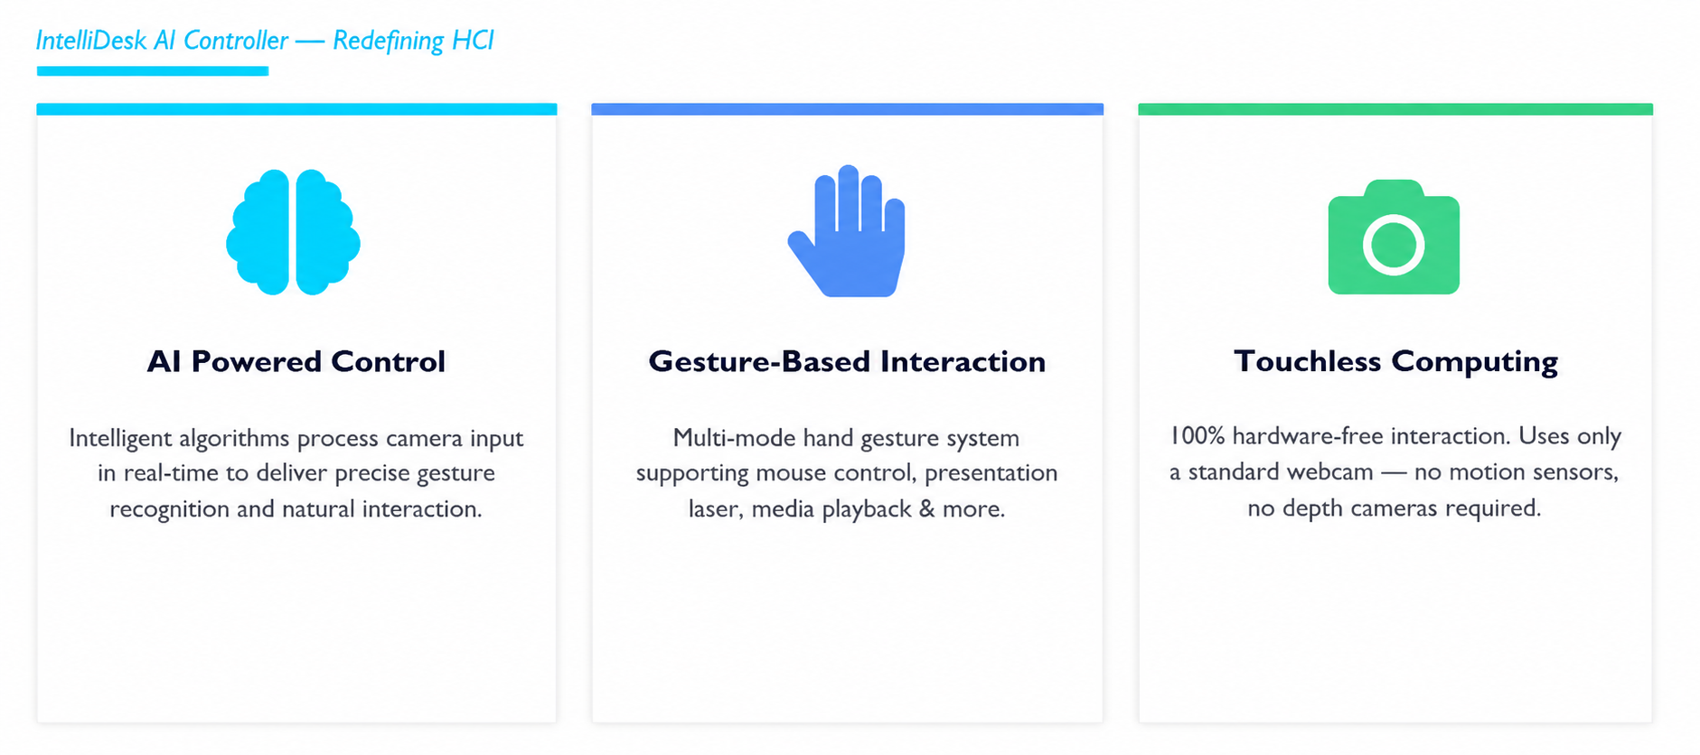
Introduction

Slide 4
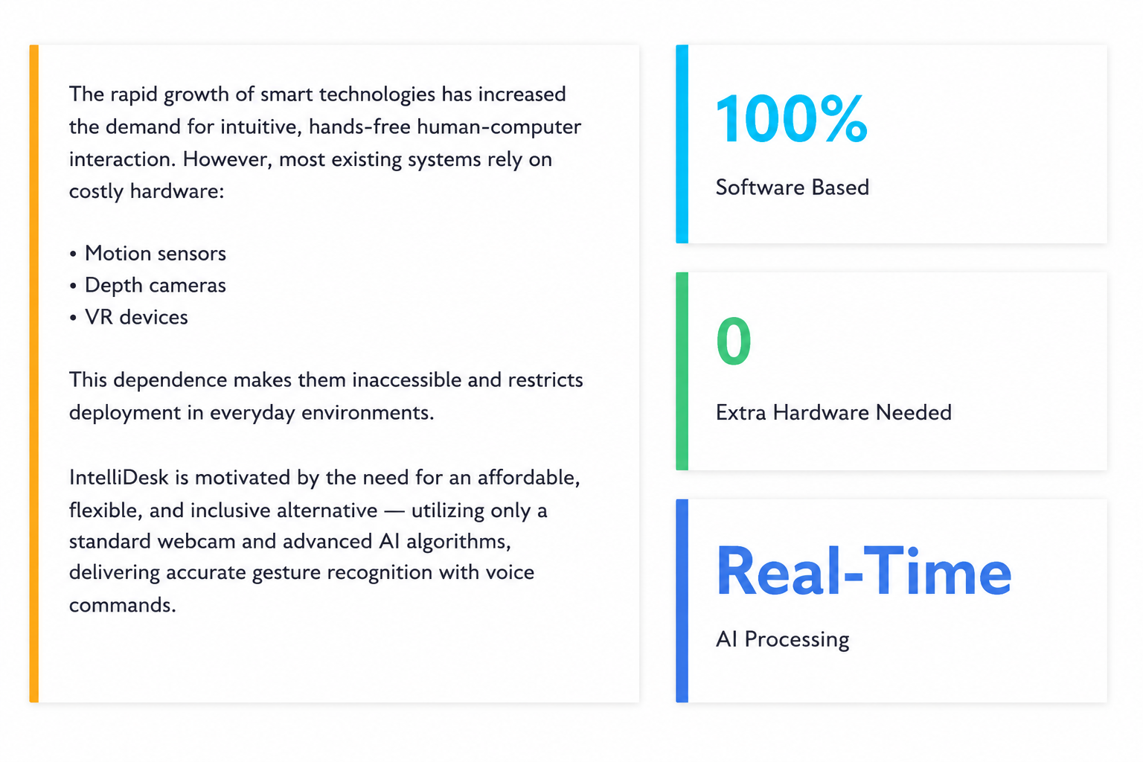

Slide 5
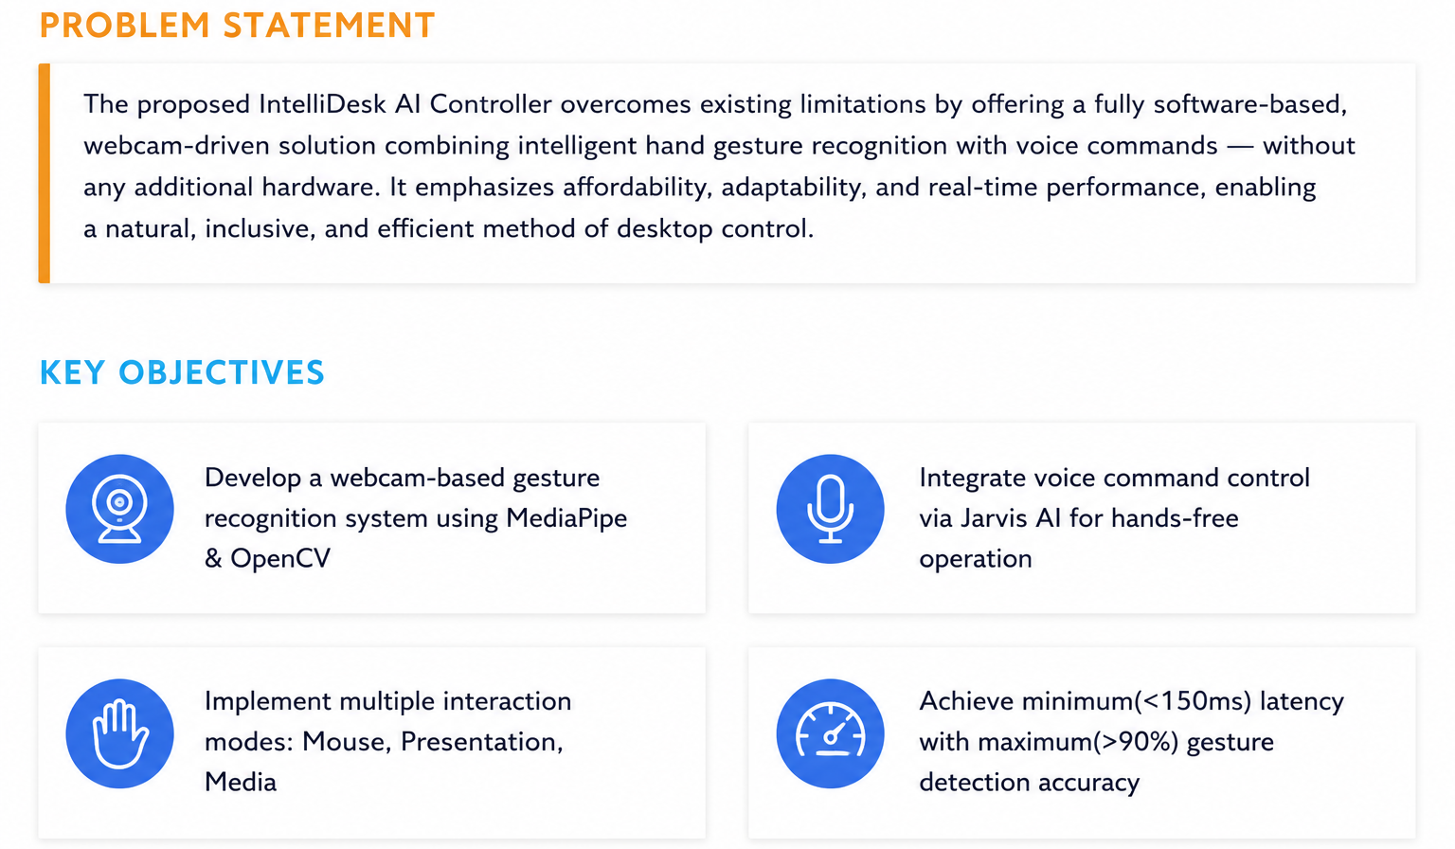
Objective & Problem Statement

Slide 6
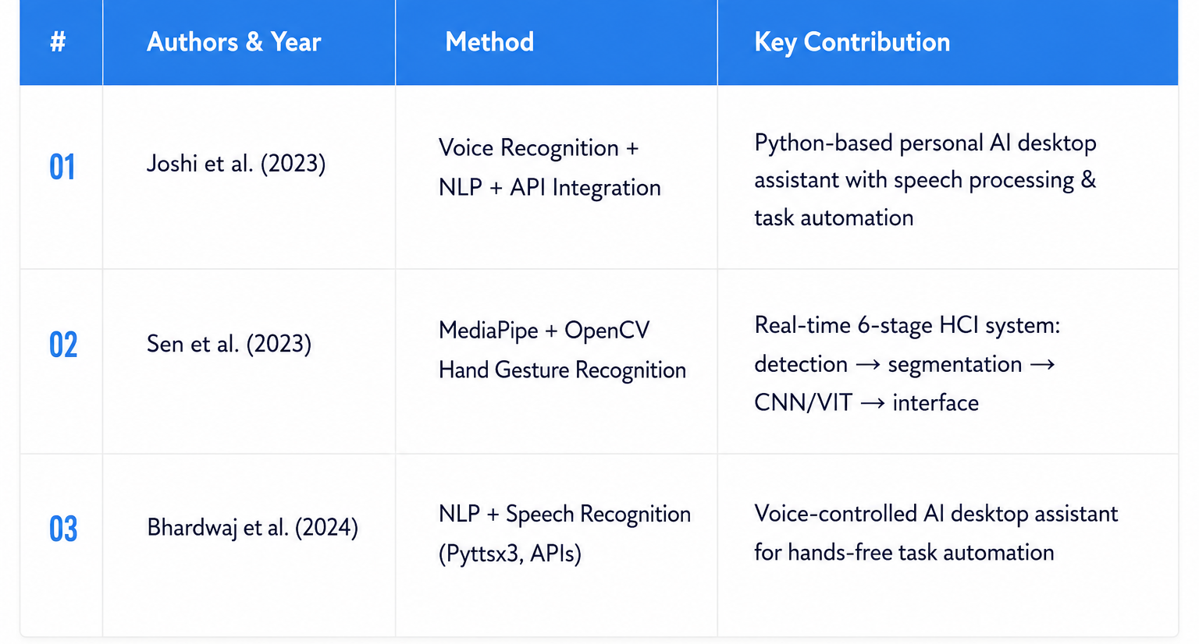
Literature Survey

Slide 7
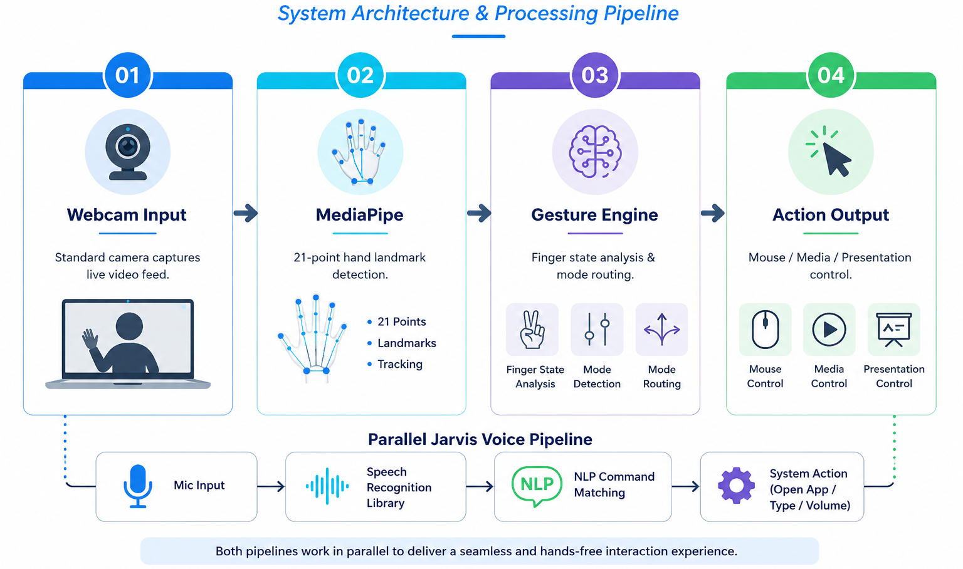
Proposed Methodology

Slide 8
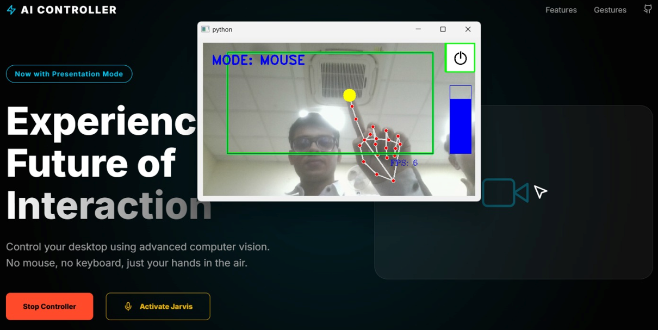
Implementation

Slide 9
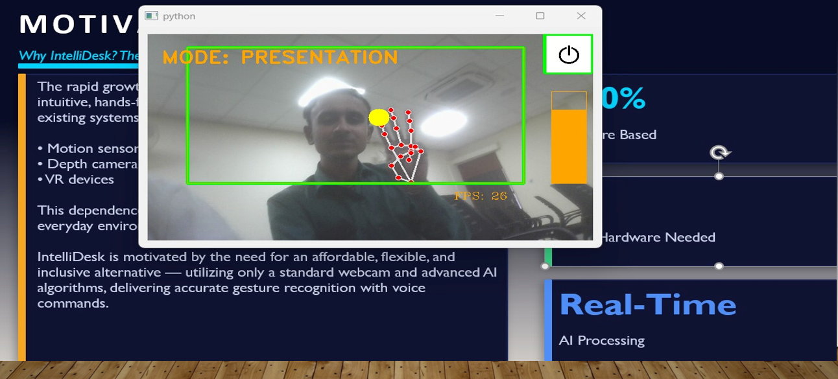
Implementation

Slide 10
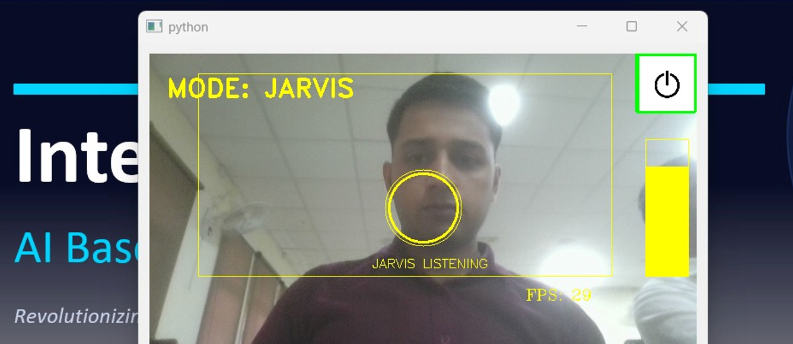
Implementation

Slide 11
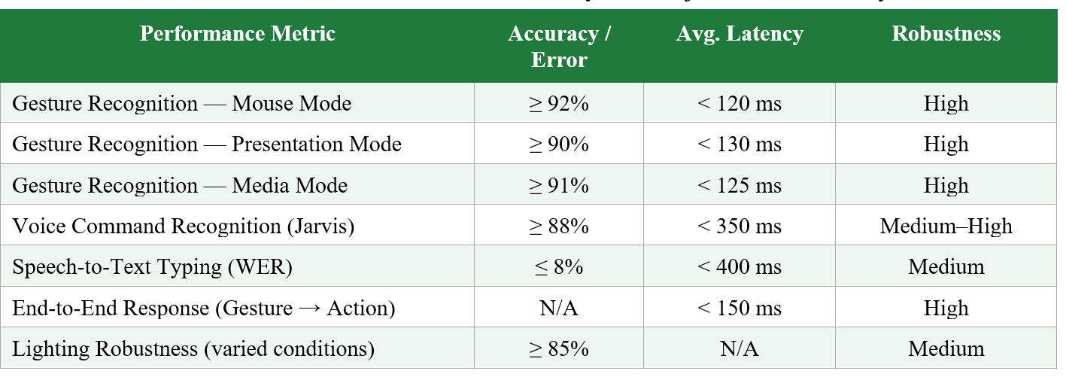
Result
The proposed IntelliDesk AI Controller demonstrated reliable real-time performance across multiple interaction modes including gesture control & voice assistance .Experimental evaluation was conducted under different lighting and usage conditions to measure system accuracy, response latency, and robustness. The gesture recognition pipeline achieved high precision with low latency due to MediaPipe-based hand tracking and optimized OpenCV processing. Overall, the system successfully delivered smooth and accurate human-computer interaction suitable for intelligent desktop automation.

Slide 12
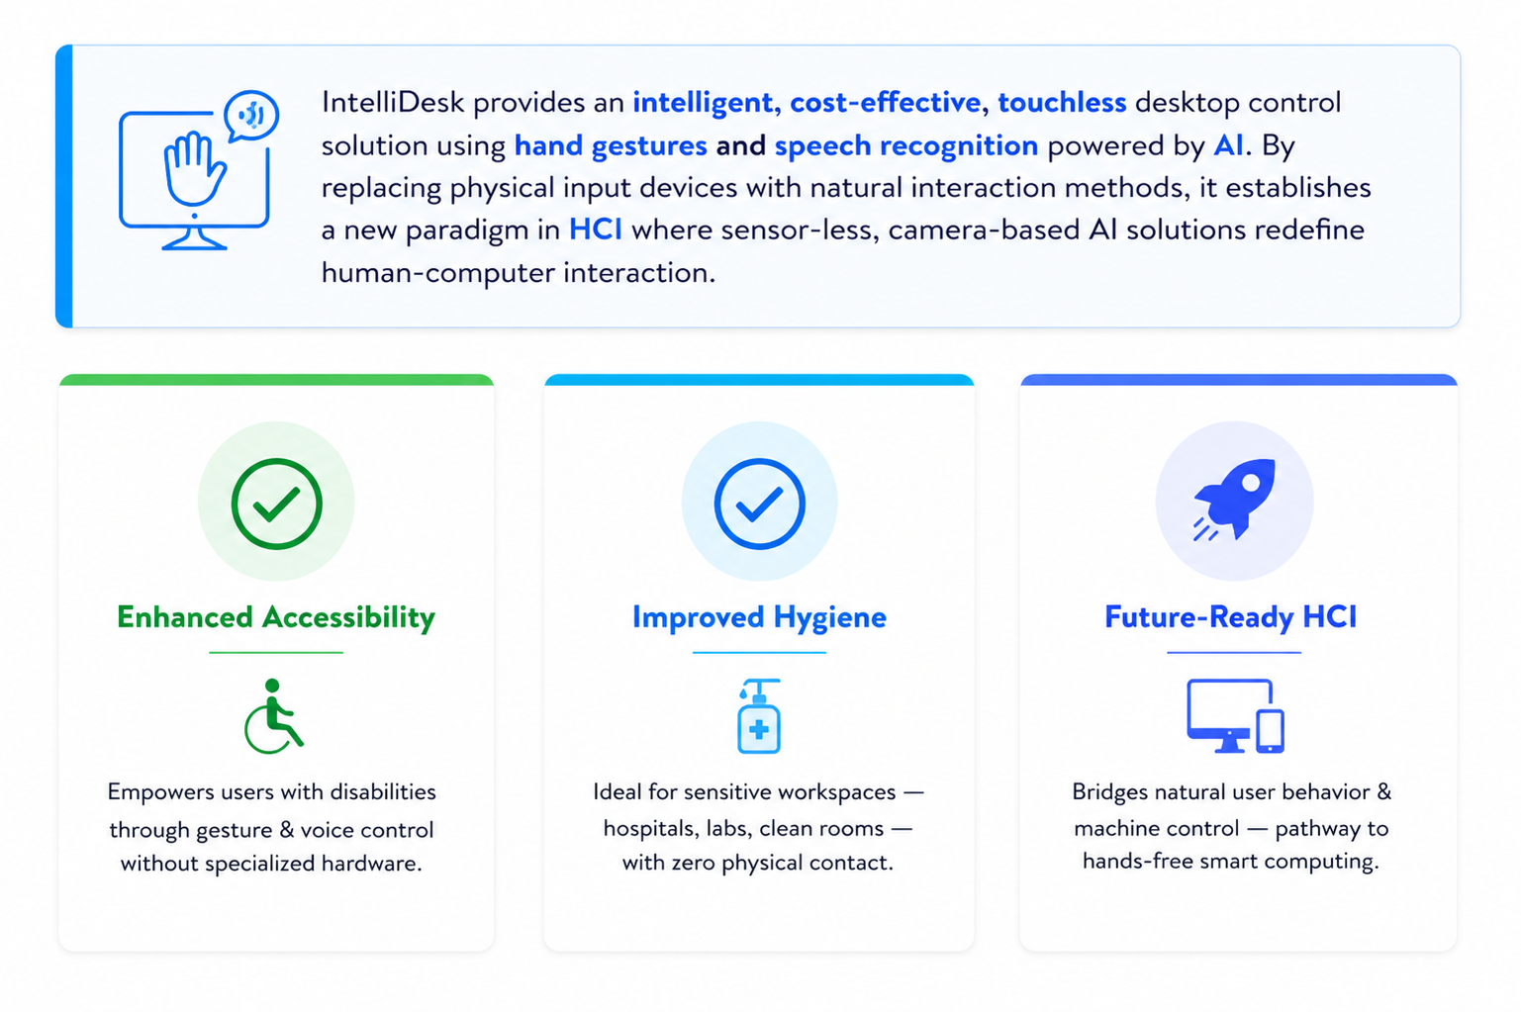
Conclusion

Slide 13
Future Scope
🔵 AI-Based Gesture Recognition
Improve gesture detection accuracy using Deep Learning techniques and adaptive learning models.
🟣 AR/VR Integration
Enable immersive interaction in virtual and augmented reality environments through natural gestures.
🟢 Smart Home & IoT Control
Extend the system to control smart devices and home appliances using gesture commands.
🟠 Personalized User Adaptation
Allow the system to learn user-specific gesture patterns for improved comfort and usability.
🔴 Accessibility Enhancement
Provide touchless interaction support for differently-abled users through voice and gesture control.

Slide 14
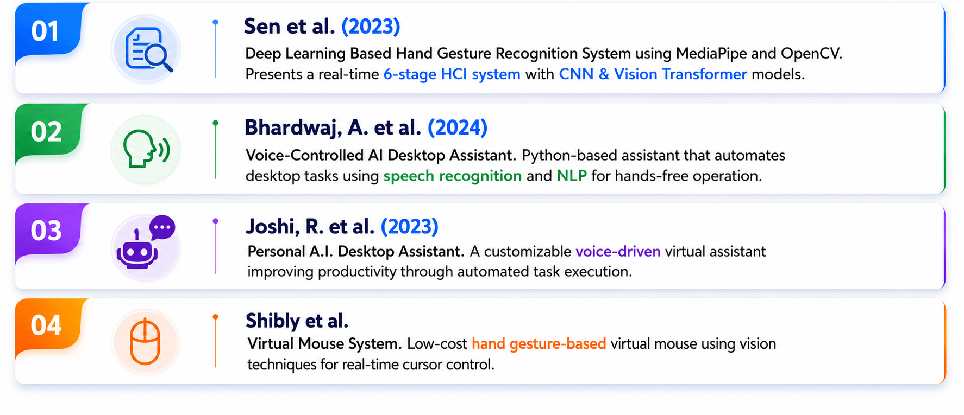
References

Slide 15
Thank You !!

Slide 16

Accessibility
Project Accessibility for Next Batch
Availability as Student Mentor

